Slide 1
POLARIZATION
The Phenomenon of restricting the vibration of Electric field vector to one plane

Slide 2
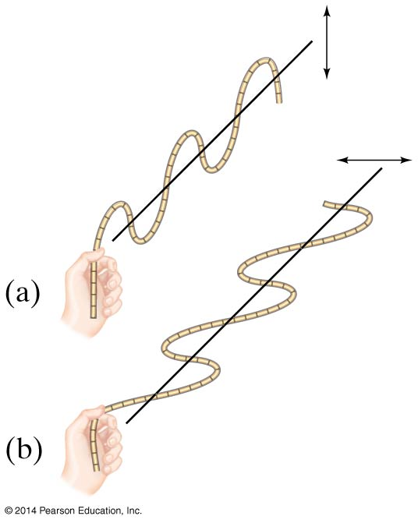
Polarization
Light is polarized when its electric fields oscillate in a single plane, rather than in any direction perpendicular to the direction of propagation.

Slide 3
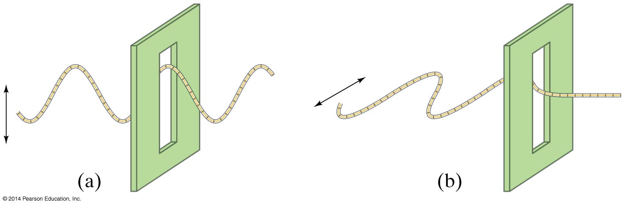
Polarization
Polarized light will not be transmitted through a polarized film whose axis is perpendicular to the polarization direction.

Slide 4
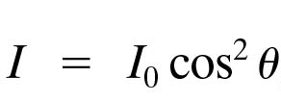
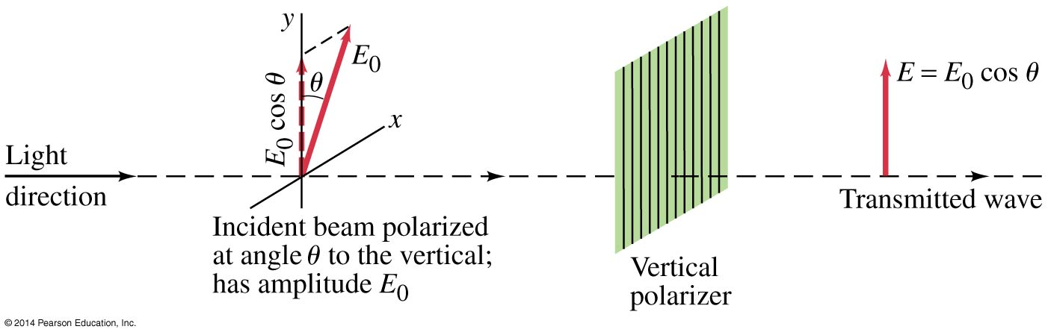
Polarization
When light passes through a polarizer, only the component parallel to the polarization axis is transmitted. If the incoming light is plane-polarized, the outgoing intensity is:
(24-5)

Slide 5
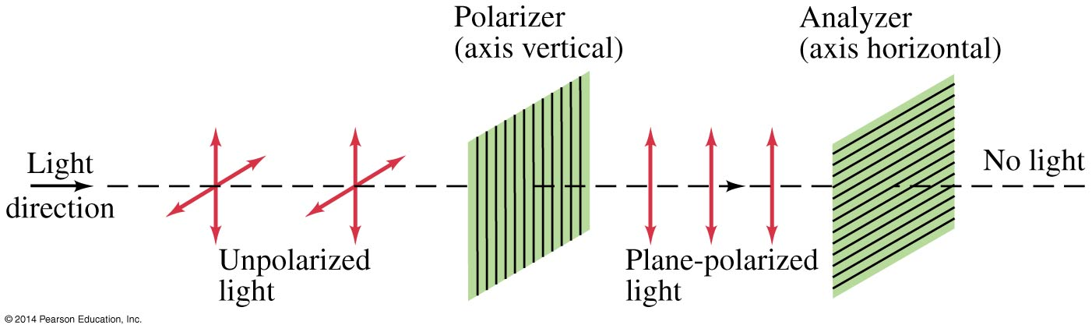
Polarization
This means that if initially unpolarized light passes through crossed polarizers, no light will get through the second one.

Slide 6
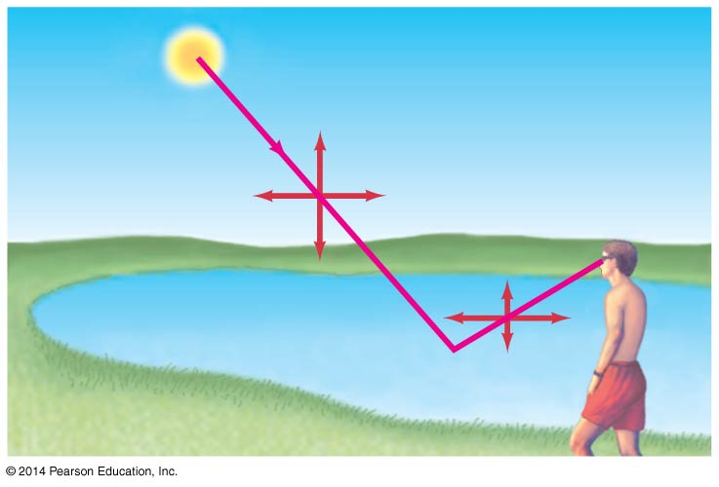
Polarization
Light is also partially polarized after reflecting from a nonmetallic surface. At a special angle, called the polarizing angle or Brewster’s angle, the polarization is 100%.
(24-6a)

Slide 7
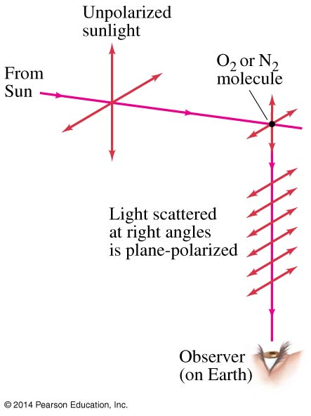
Scattering of Light by the Atmosphere
Skylight is partially polarized due to scattering from molecules in the air. The amount of polarization depends on the angle that your line of sight makes with the sun.

Slide 8
REVISION
Light whose electric fields are all in the same plane is called plane polarized
The intensity of plane polarized light is reduced after it passes through another polarizer:
Light can also be polarized by reflection; it is completely polarized when the reflection angle is the polarization angle:

